Slide 1

Advance Artificial Intelligence : Developing An
Intelligent Chatbot System
Module : CMP-7059B
Group : PG_04
Members : Rajvi Panchal(100536007)
Bibisha Bishwokarma(100536874)
Harshini Pothireddy(100530769)

Slide 2
Introduction
Task 1: Finding the cheapest train ticket
This project focuses on developing a conversational chatbot that helps users search for train tickets.
The chatbot collects journey information through a step-by-step dialogue and then returns a suitable ticket option with a booking link.
The system was designed for users who may not want to manually search through train websites and instead prefer a guided conversation.
To help their customers in finding the cheapest available ticket for their intended journey in the UK

Slide 3
What the Chatbot Is Designed to Do??
The main objective of the first task was to build a chatbot that can help users find the cheapest available train ticket for their journey.
To do this, the chatbot needs to understand the user’s travel request, collect missing information such as departure station, destination station, travel date, time, and ticket type, and then produce a ticket result.
The chatbot also supports extra journey details such as return tickets and railcards. This makes the conversation more realistic because many passengers need discounts or return journeys when booking train tickets.

Slide 4
Development Approach: How the System Was Built?
The chatbot was developed as a FastAPI web application. The backend handles the conversation logic, ticket search process, station validation, and API communication. The frontend provides a simple chat interface where the user can type messages and receive chatbot responses.
The system was divided into separate Python files so each part had a clear responsibility. For example, conversation.py manages the dialogue, nlu.py detects intent and extracts journey details, ticket_api.py connects to the National Rail API, and services.py handles ticket search and fare calculation.

Slide 5
Conversation Design : Collecting Journey Details Step by Step
The chatbot uses a slot-filling approach. This means it checks which information has already been collected and asks for anything missing. For example, if the user only says they want a ticket, the bot asks for the departure station. After that, it asks for the destination, date and time, ticket type, and railcard information.
This approach makes the chatbot easier to use because the user does not need to provide every detail in one sentence. The conversation continues naturally until enough information has been collected to search for a ticket
Ticket Search and API Integration : Using National Rail Data Where Available
The chatbot attempts to use the National Rail journey planner API to retrieve journey information. The API request includes the origin station, destination station, travel time, passenger details, and railcard information where available.
When the API returns useful journey details, such as departure time, arrival time, platform, duration, or price, the chatbot uses those values. However, API responses may not always include complete fare or platform information. To handle this, the system includes fallback logic so the chatbot can still complete the conversation.

Slide 6
Fare Handling : Combining API Data with Fallback Fare Logic
One challenge during development was that the API did not always return ticket prices. To avoid the chatbot failing or showing no result, a fallback fare engine was implemented. If the API returns a real price, the chatbot uses that price. If the API does not return a price, the chatbot uses a deterministic estimated fare.
This fallback keeps the chatbot functional during testing and demonstration. It also makes the behaviour more reliable because the user still receives a ticket result even when the live API response is incomplete.
Railcard Discount Implementation : Adding Discount Support
A railcard feature was added so users can apply discounts to their ticket. The chatbot first asks whether the user has a railcard. If the user says yes, it asks which railcard they want to use. It supports common UK railcards such as 16-25, Senior, Disabled Persons, Family & Friends, Two Together, Network, and Veterans.
During testing, an issue occurred where typing 16-25 was incorrectly treated as a journey time or date. This was fixed by making the railcard collection state-aware. When the bot is asking for a railcard, the system now interprets the user’s answer only as a railcard response, not as travel time information.

Slide 7
Station Validation : Improving Station Name Accuracy
Station names are loaded from a station CSV file. During testing, the chatbot sometimes selected non-passenger railway locations, such as sidings, or chose the wrong station when a name had multiple matches. For example, a user typing Oxford could be matched with Manchester Oxford Road.
To improve this, station matching was refined. Exact station names are now prioritised over partial matches. Non-passenger locations such as sidings, depots, and internal rail locations are filtered out. This makes the chatbot more suitable for passenger ticket searches.
Return Ticket Support : Handling Outward and Return Journeys
The chatbot was extended to support return tickets. If the user says they want a return ticket, the bot asks for the return date and time. The final response then displays separate outward and return journey sections.
This makes the chatbot match the task requirements more closely, because the task example includes journeys where the passenger travels out and comes back later. The chatbot now collects both outward and return journey details before presenting the ticket result.

Slide 8
Error Handling and Fallbacks : Making the Chatbot More Reliable
Several fallback mechanisms were added to make the chatbot more reliable. If the API does not return platform details, the chatbot displays “Platform: To be announced” instead of showing fake platform numbers. If the API does not return a price, the chatbot uses the fallback fare. If the user enters an invalid station, the chatbot asks for a valid UK station name.
These improvements make the chatbot more professional because it avoids displaying misleading information where possible.
Testing and Improvements : How the Chatbot Was Tested
The chatbot was tested using common journey examples such as Norwich to London, Norwich to Oxford, and return journeys. Railcard scenarios were also tested to confirm that discounts were applied correctly.
Testing helped identify several issues, including incorrect railcard parsing, wrong station matching, fixed mock platform numbers, and missing return journey handling. Each issue was fixed step by step, improving the chatbot’s accuracy and usability.

Slide 9
Final Outcome : What the Chatbot Can Do Now
The final chatbot can collect journey details through conversation, validate station names, support single and return tickets, apply railcard discounts, use API journey data when available, and provide a ticket result with a booking link.
Although some fallback logic is still used when API data is incomplete, the chatbot meets the main objective of guiding the user through the ticket search process and presenting a suitable train ticket option.
Limitations : Current System Limitations
The main limitation is that the API does not always return complete live fare, platform, or duration information. Because of this, fallback data is sometimes used. The chatbot also currently presents one ticket option rather than comparing multiple live ticket providers.
In a future version, the chatbot could be improved by showing multiple ticket options, generating more accurate booking links, supporting before or after departure preferences, and improving real-time journey data handling.

Slide 10
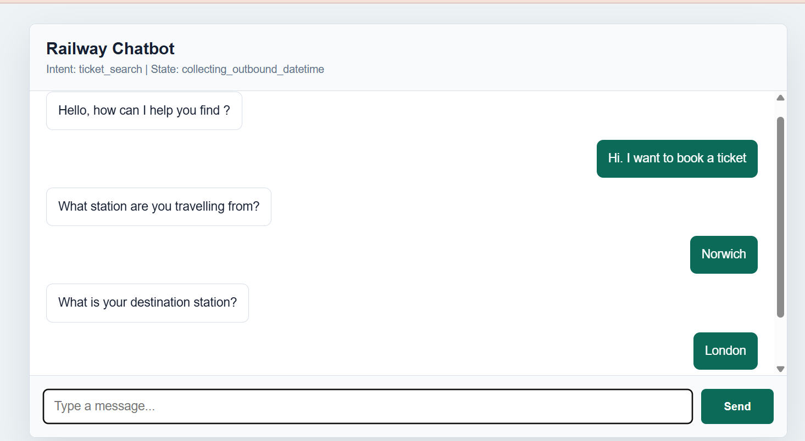
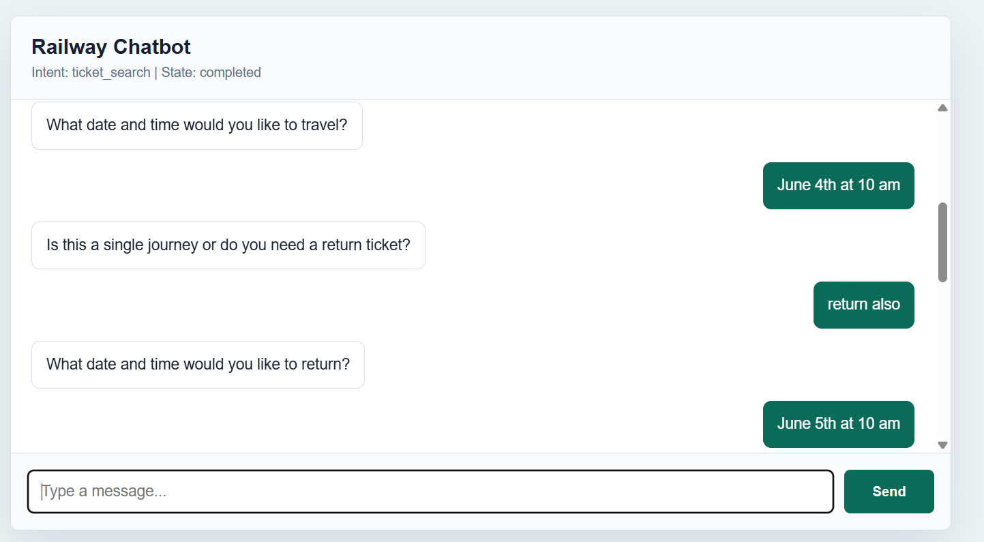
OUTPUT

Slide 11
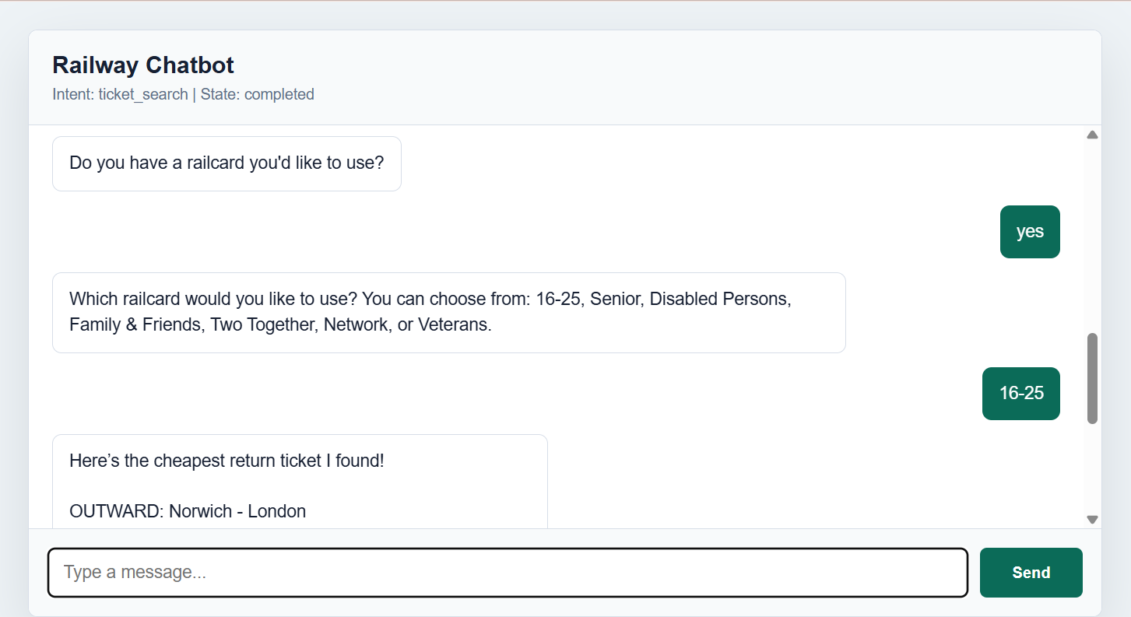
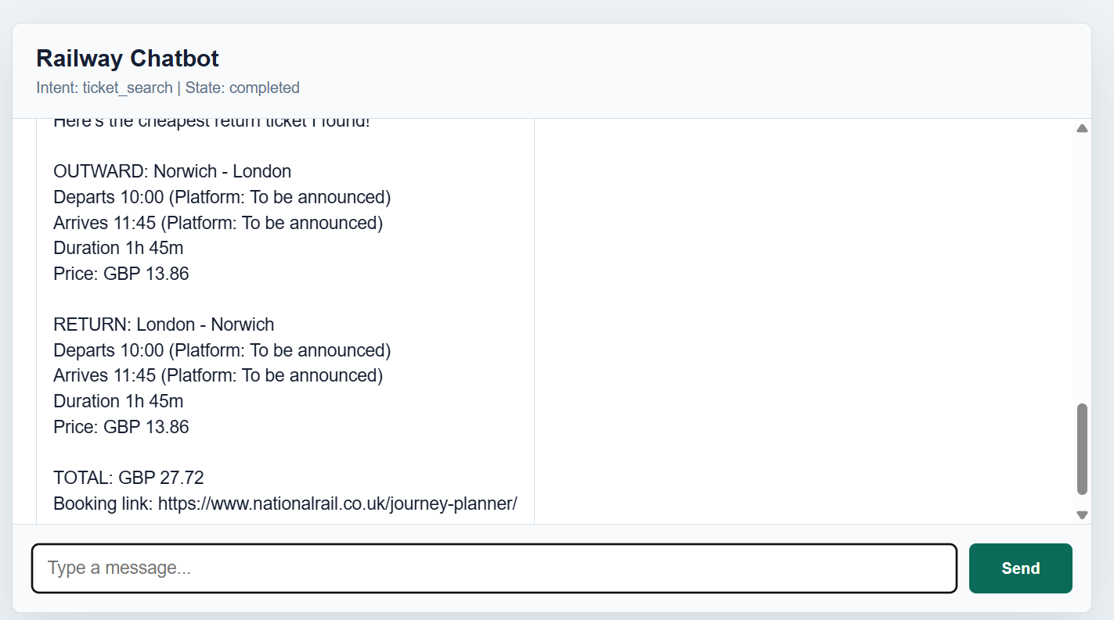
OUTPUT

Slide 12
PURPOSE
Task 2: Improving Customer Service
Goal: predict the estimated arrival time of a delayed train
Scenario: passenger on Weymouth to London Waterloo (South Western Railway) service
Train is delayed at an intermediate station (Southampton)
Chatbot collects journey info and returns a predicted arrival time
Predict the estimated arrival time of a delayed train

Slide 13
Data Preprocessing
Historical train performance data from South Western Railway (WAT↔WEY route)
Two direction-specific datasets: WAT to WEY and WEY to WAT
Data split: 70% training / 15% validation / 15% testing for hyperparameter tuning
80/20 for final model

Slide 14
Model Training
Three algorithms were trained and compared.
Random Forest
XGBoost
KNN Regressor
Ensemble of decision trees
Robust to noise
n_estimators = [50, 100, 200]
max_depth = [5, 10, 20, None]
gradient boosted trees
often stronger on tabular data
n_estimators = [100, 200, 300]
max_depth = [3, 5, 7]
learning_rate = 0.1
predicts based on k nearest historical examples
tuned over k values [3,5,10,15,20]
Best config per model selected by lowest validation RMSE

Slide 15
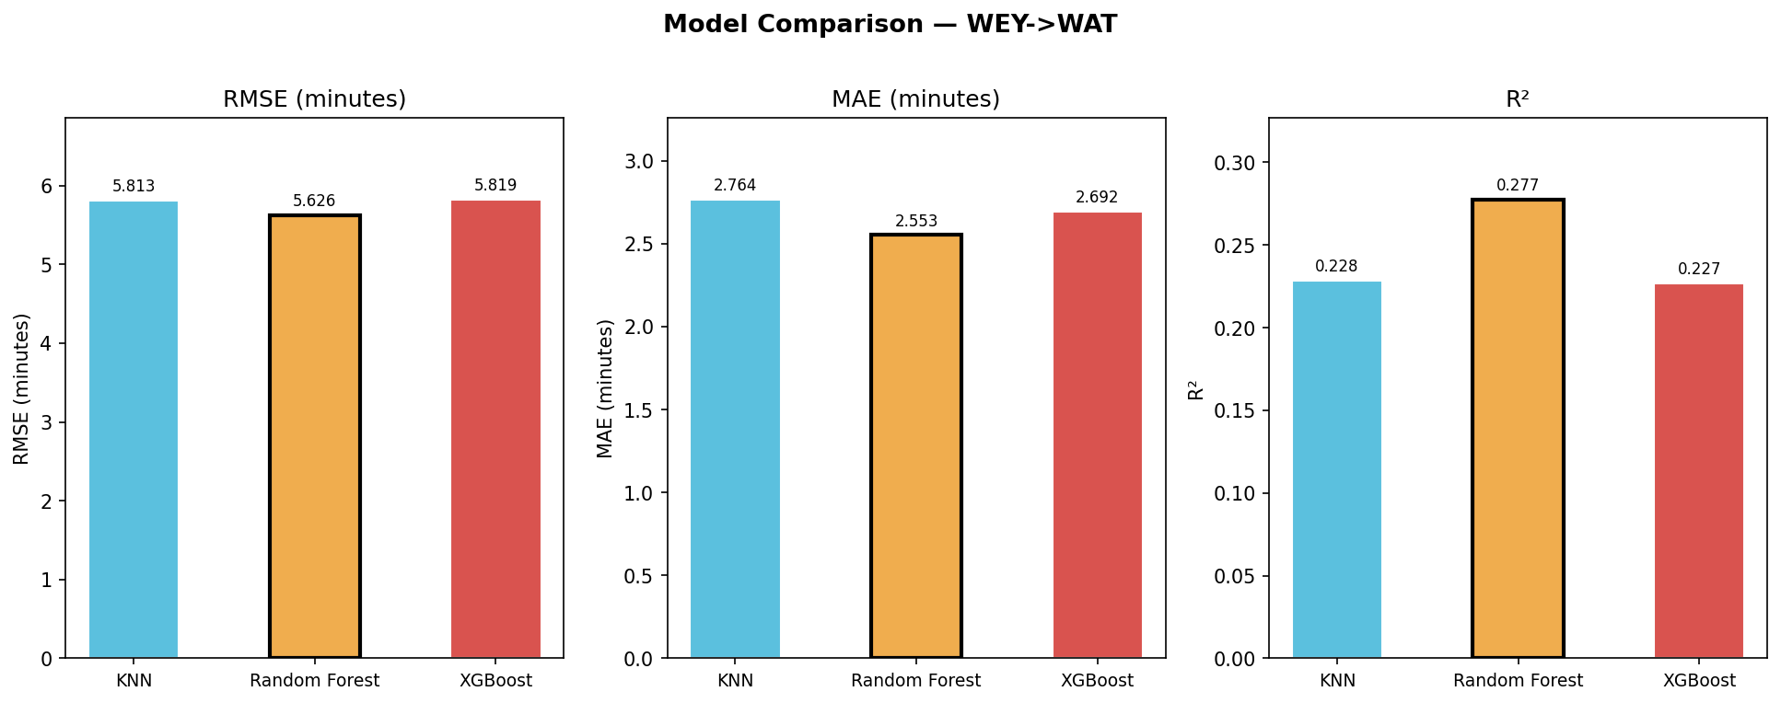
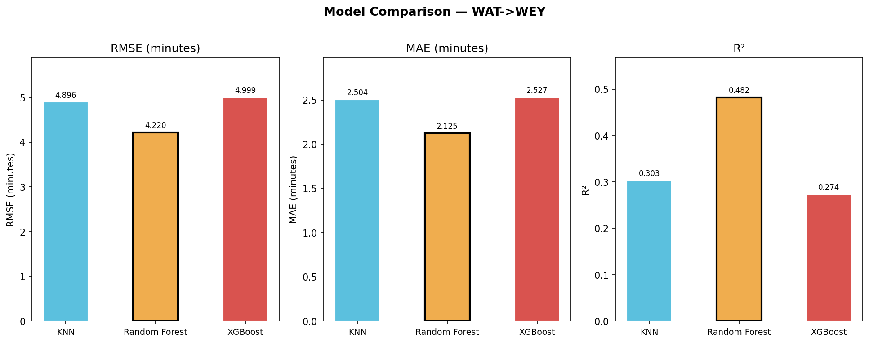
Model Comparison

Slide 16
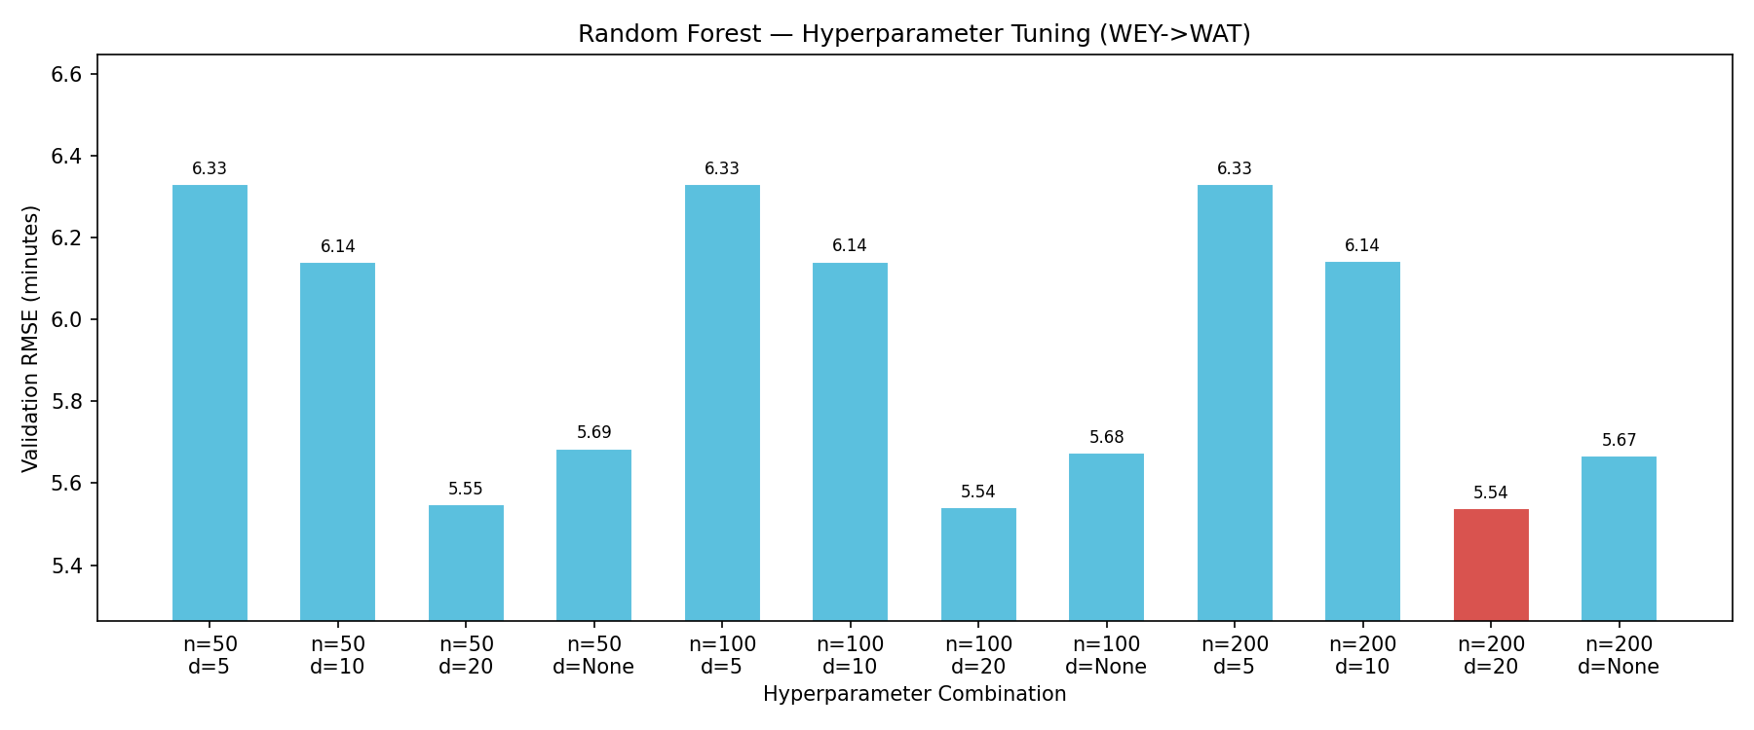
Hyperparameter Tuning Random Forest (WEY -> WAT)

Slide 17
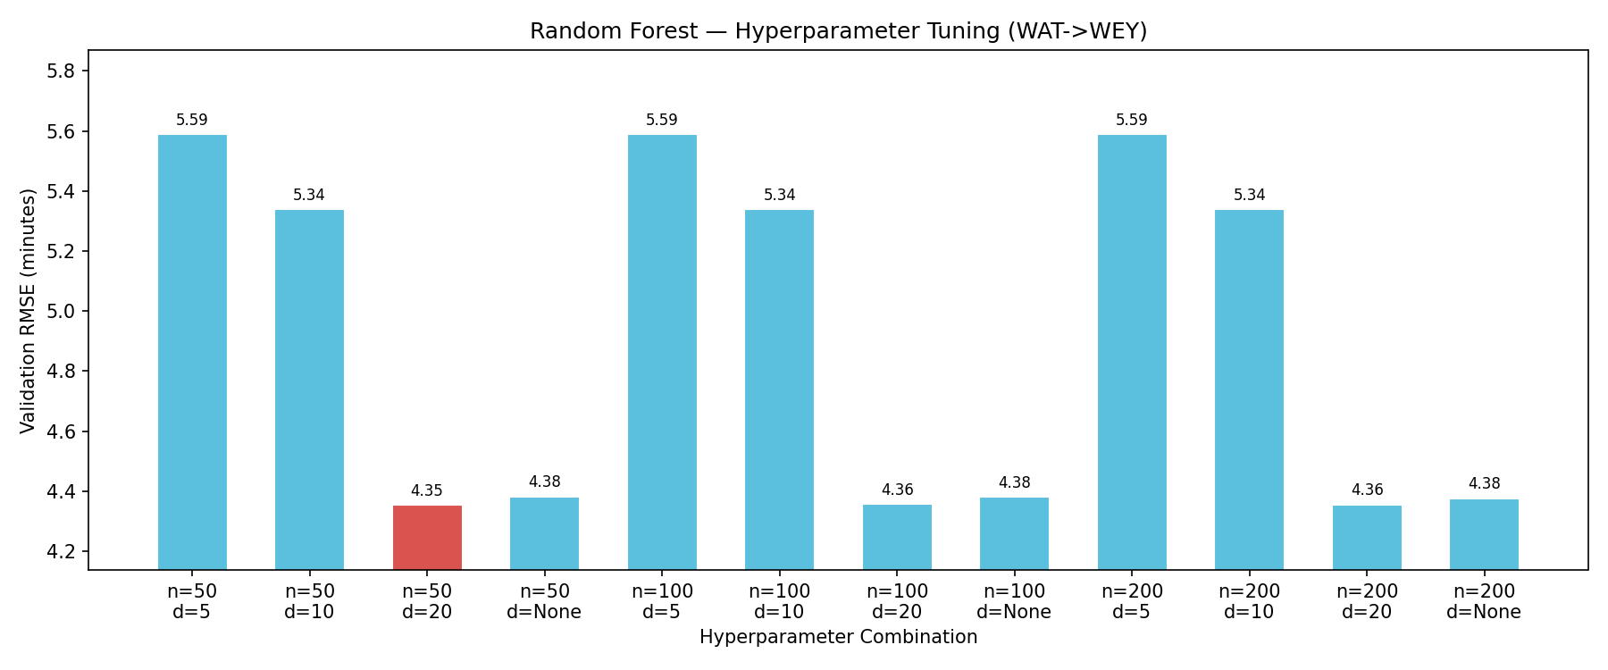
Hyperparameter Tuning Random Forest (WAT -> WEY)

Slide 18
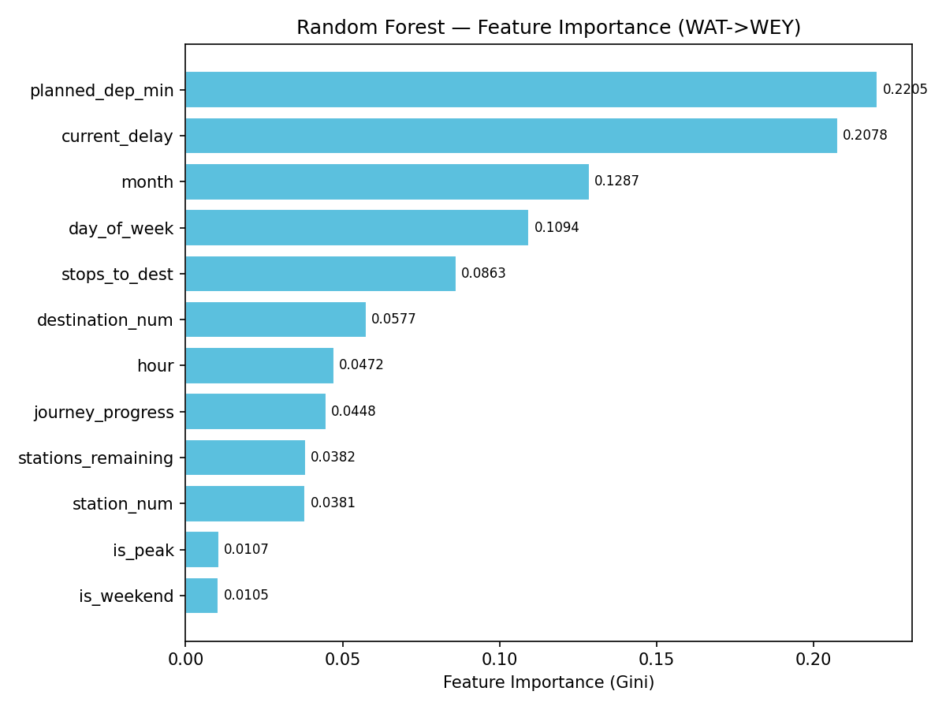
Feature
Importance

Slide 19
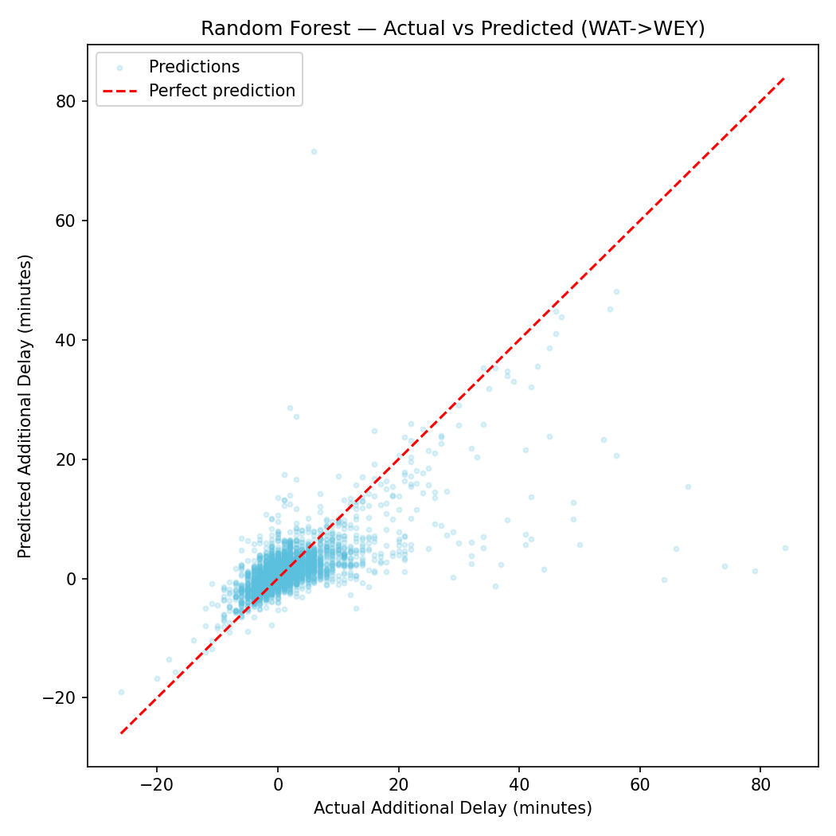
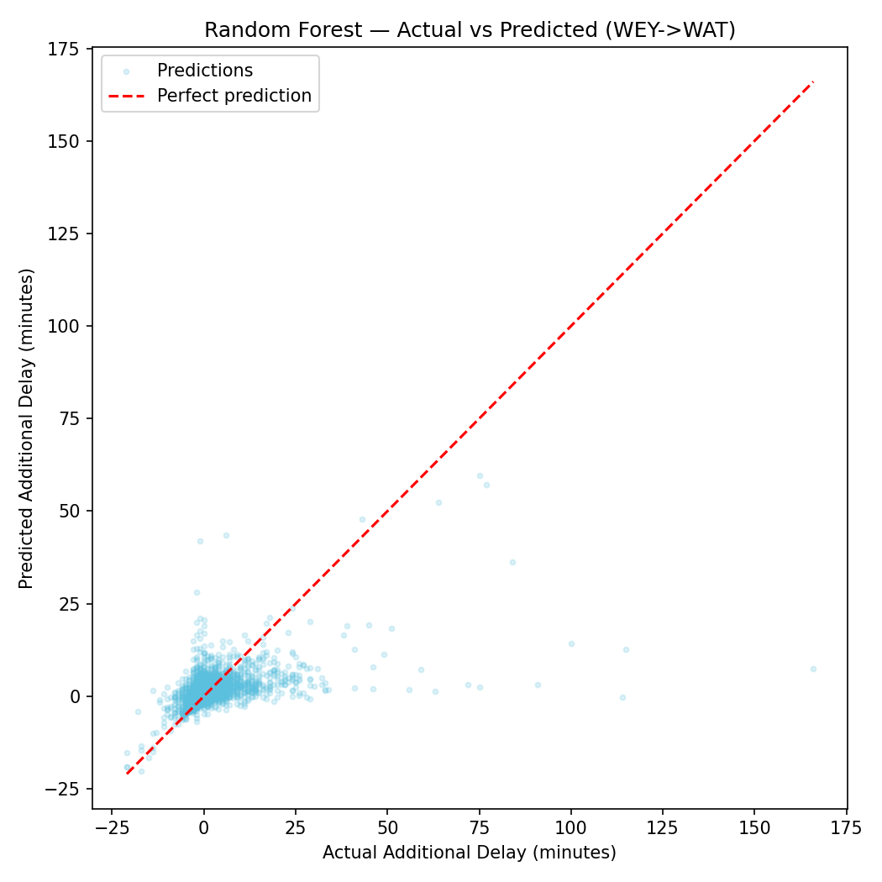
Random Forest - Actual vs Predicted (WAT <-> WEY)

Slide 20
Chatbot collects 6 slots through conversation:
Direction (WAT2WEY or WEY2WAT)
Origin station
Destination station
Planned arrival time (HH:MM)
Current station
Current delay (minutes)
Input validated at each step
Total delay = current delay + predicted additional delay
Chatbot
Integration

Slide 21
TASK 3 / RAILWAY DISRUPTION EXPERT SYSTEM
Task 3:
CENTRAL PURPOSE
Railway Disruption
Expert System
Task 3 transforms the chatbot into an explainable assistant for railway disruption planning.
It supports line blockage and station disruption enquiries.
How the railway chatbot retrieves focused contingency guidance for disruption scenarios.
It returns selected operational guidance for staff and passenger needs.
Railway Chatbot / Staff Contingency Plan Assistant
It retrieves existing expert knowledge; it does not predict delays or control live services.

Slide 22
TASK 3 / RAILWAY DISRUPTION EXPERT SYSTEM
What is an expert system?
Task 3 is built around stored domain knowledge and reasoning logic, rather than prediction.
HOW THIS APPLIES TO TASK 3
An expert system is an AI system that uses specialist knowledge, facts and decision rules to provide advice similar to a human expert.
Knowledge base: contingency plans and station disruption guidance provide the stored operational expertise.
Reasoning: the incident type, location, blockage condition and required audience determine which guidance is returned.
Its value is explainability: the recommendation can be linked back to stored guidance and the information supplied by the user.
Interface: a guided chatbot conversation collects missing incident details before presenting advice.
In this project, the expert domain is railway disruption response.
Difference from ML: Task 3 selects guidance; it is not trained to predict disruption outcomes.

Slide 23
TASK 3 / RAILWAY DISRUPTION EXPERT SYSTEM
Why expert system is needed ??
Railway disruption decisions depend on finding the right instruction quickly and consistently.
THE OPERATIONAL PROBLEM
TASK 3 SCOPE
Disruption guidance is distributed through line contingency plans and station disruption documents, with different information for different roles.
Two supported disruption scenarios
Line blockage: the assistant collects an affected line section and whether the blockage is partial or full.
Manual document searching can be slow during an incident and may lead to inconsistent retrieval of relevant advice.
Station disruption: the assistant collects the affected station and the required type of guidance.
Users may know the incident location and need, but not which source document contains the correct procedure.
Purpose: provide a faster guided route to focused existing contingency advice, not create new railway rules.

Slide 24
TASK 3 / RAILWAY DISRUPTION EXPERT SYSTEM
KNOWLEDGE BASE
How expert knowledge was prepared
The system turns operational documents into structured records and searchable semantic rule chunks.
KNOWLEDGE SOURCE AND STORED USE
Source material
Content captured
How it uses
Line contingency plans
Route sections, blockage type and role-specific advice
SQLite supports exact plan selection for line blockage requests.
Station disruption plans
Local communications, Control contact and station operation tips
Station-specific answers are returned for staff or passenger need.
Extracted rule chunks
Searchable textual knowledge prepared during ingestion
ChromaDB can support natural-language retrieval when structured fields are incomplete.
VERIFIED IMPLEMENTATION SCALE
72
195
1,905
2299
3496
line contingency plans
station disruption plans
station tips
knowledge files
ChromaDB chunks

Slide 25
TASK 3 / RAILWAY DISRUPTION EXPERT SYSTEM
USER INTERACTION
What expert system adds to the chatbot
A guided conversation gathers enough incident detail before the expert system returns advice.
INCIDENT WORKFLOW 1 | LINE BLOCKAGE
INCIDENT WORKFLOW 2 | STATION DISRUPTION
The assistant asks which two stations or locations define the affected line section.
The assistant asks which station is affected, then confirms that station before searching for advice.
It requests confirmation of the location, then asks whether the blockage is partial or full.
Users can request station staff advice, signaller information, passenger information, service alterations, alternative journeys or all guidance.
Once the blockage condition is confirmed, it asks which type of operational advice is needed.
The final response is audience-focused, so users are not forced to read all stored material for every incident.
Example: both lines blocked between Woking and Guildford.
Example: station staff advice for disruption at Bournemouth.

Slide 26
TASK 3 / RAILWAY DISRUPTION EXPERT SYSTEM
IMPLEMENTED WORKFLOW
How the expert system works
IMPLEMENTED TECHNICAL FLOW
User
request
Browser
chat UI
FastAPI
/api/chat
Conversation
Manager
Expert
System
SQLite +
ChromaDB
Focused response
WHAT HAPPENS INSIDE THIS FLOW
1. The conversation manager stores the incident slots and asks follow-up questions when required information is missing.
2. SQLite selects a structured contingency or station plan when location and incident details match.
3. ChromaDB semantic retrieval can supplement missing fields or return relevant operational guidance when exact matching is insufficient.

Slide 27
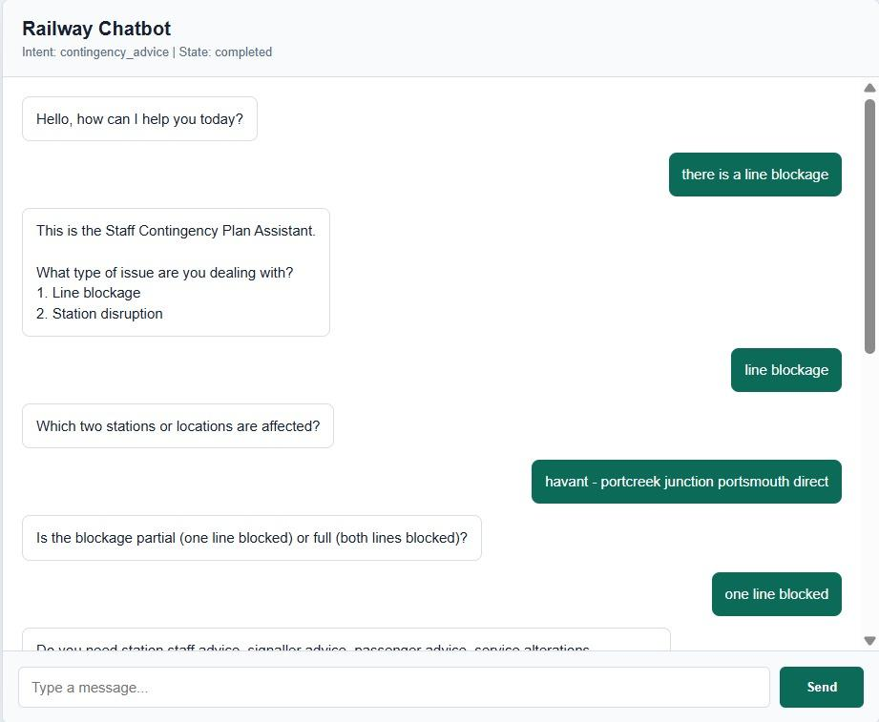
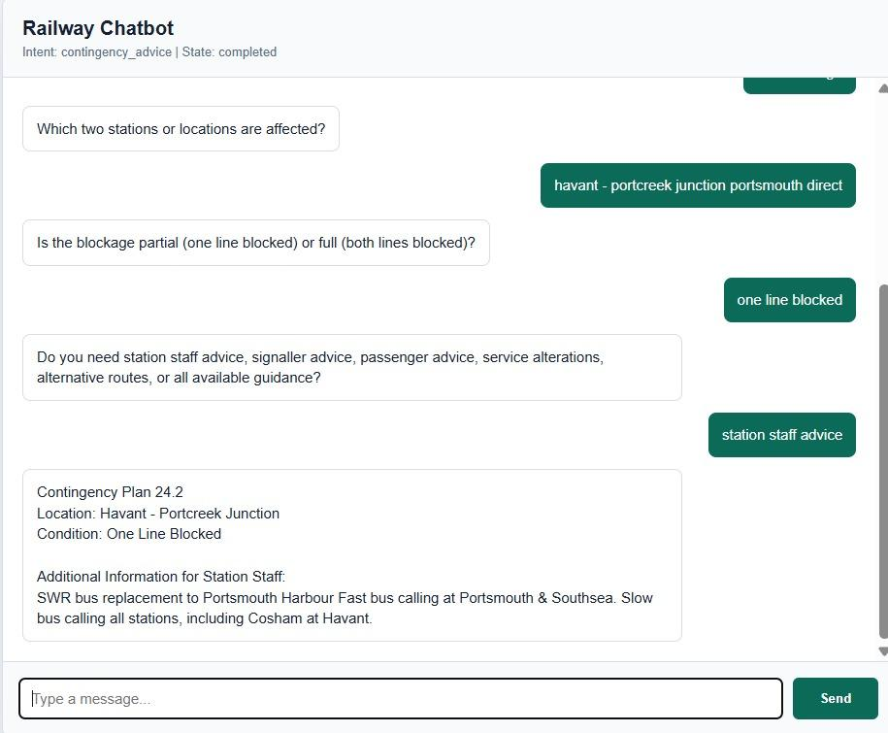
OUTPUT

Slide 28
TASK 3 / RAILWAY DISRUPTION EXPERT SYSTEM
CONCLUSION
What Task 3 achieves - and what remains
An implemented and explainable disruption-assistance feature within the wider railway chatbot.
CONCLUSION
LIMITATIONS AND IMPROVEMENTS
Task 3 changes the chatbot from a general railway information interface into an expert-system assistant for disruption planning.
Quality depends on the accuracy and completeness of the extracted contingency documents.
Unusual station spelling or route wording can reduce matching reliability; stronger alias normalisation is a sensible improvement.
It guides users to relevant existing advice for line blockages and station disruptions.
Regression tests and an admin evidence view would make retrieval behaviour easier to validate.
It combines structured matching with semantic support while keeping the response clear and audience-focused.
The current system has no live railway-control connection; live integration would be future work, not a present claim.

Slide 29
CONCLUSION
We successfully developed a railway ticket chatbot that supports a realistic user conversation. The system collects all required journey information, handles railcards and return tickets, validates station names, and uses National Rail API data where available.
The development process involved solving practical chatbot issues such as incomplete API data, ambiguous station names, and railcard parsing. Overall, the chatbot provides a useful and interactive way for users to search for train tickets.
We developed a train delay prediction system for users to predict when their delayed train will arrive at their destination.
We successfully developed an expert-system chatbot for railway disruption guidance. It collects key incident details through conversation and returns clear operational advice.
We successfully developed a hybrid retrieval approach using SQLite and ChromaDB. This helps the chatbot match structured disruption details while also handling natural user wording.

Slide 30
THANK YOU

